Slide 1
Gender Prediction Based on Vietnamese Names
1
Phạm Lê Trưởng - 20522090
Trần Phương Thảo - 20521938

Slide 2
Abstract
2
Nowadays, much work has been done on gender classification based on people’s names. There have been a lot of proposals for English and Chinese names. But for Vietnamese names, very few have been done so far.
Dataset comprises 30,000 full names annotated with genders. We examined and implemented 6 ML algorithms (Naive bayes, Logistics Regression, SVM, KNN, Decision tree, Random Forest).
As a result, the best F1-score that we have achieved is up to 95% on SVM model and we generate a web API based on our trained model

Slide 3
Describe
Input
Output
Tào A Tuyết
Lư Hữu Tình
Ma Thị Bích Ngọc
Hồ Thị Thanh Nhàn
Nam
Nam
Nữ
Nữ
3

Slide 4
Dataset
Using UIT-ViNames and over 4,000 data samples collected from ethnic minority schools help to diversify data collection.
4

Slide 5
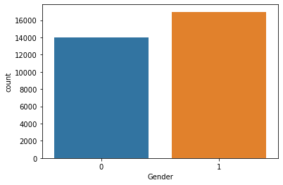
5
The dataset consists of 30,936 Vietnamese names, of which 45,15% are female names and 54,85% are male.
The labels distribution considering the gender (0 for female and 1 for male) is depicted in figure.

Slide 6
Preprocessing
01
02
03
Cut off all the last names
Removing special characters, double spacing, and correct the misspellings
Convert the names into lower case and delete duplicate data
6

Slide 7
Encoding data
01
02
CountVectorizer
TfidfVectorizer
7

Slide 8
Gender Prediction Models
Naïve Bayes
Logistic Regression
SVM
KNN
Decision tree
Random forest
8

Slide 9
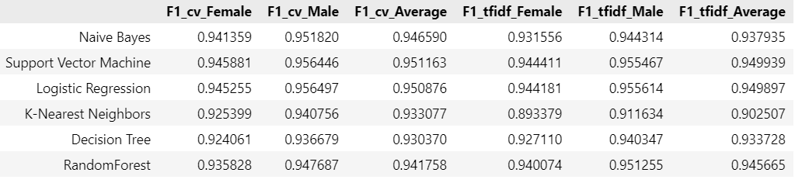
Measure
9

Slide 10
Progressing
01
Accomplished
Collected data
Preprocessed data
Encoded data and trained models
Draft report
9

Slide 11
Progressing
02
Improving
Write final report
Report slides
Generate web local based on our trained models
GridSearch CV tuning hyperparameter
10

Slide 12
Thank you
11

